Slide 1
Spark for zhc
Huichao Zhao

Slide 2
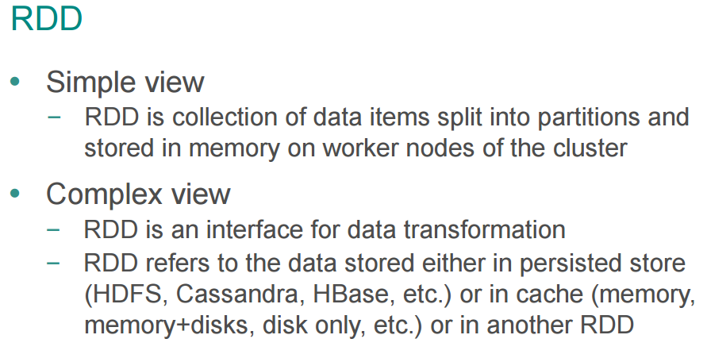
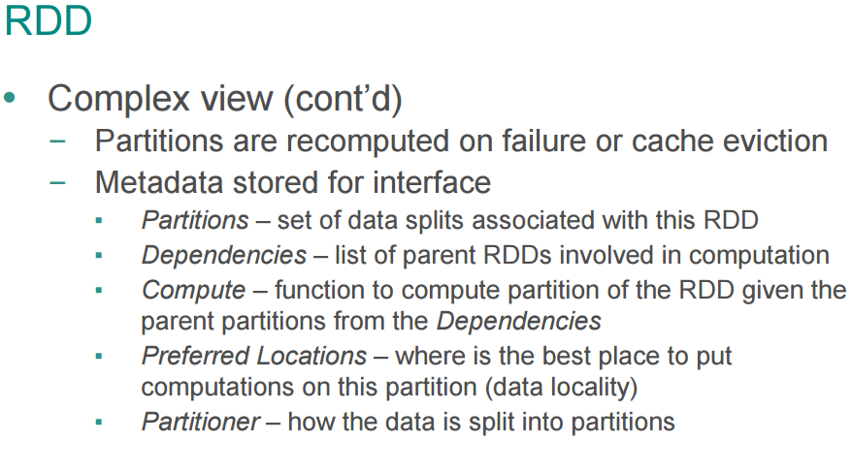
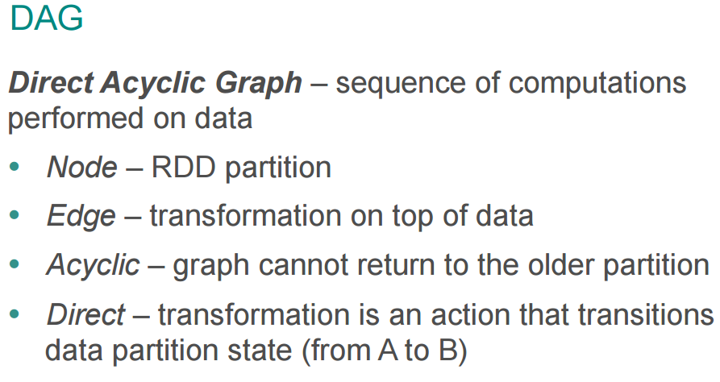

Slide 3
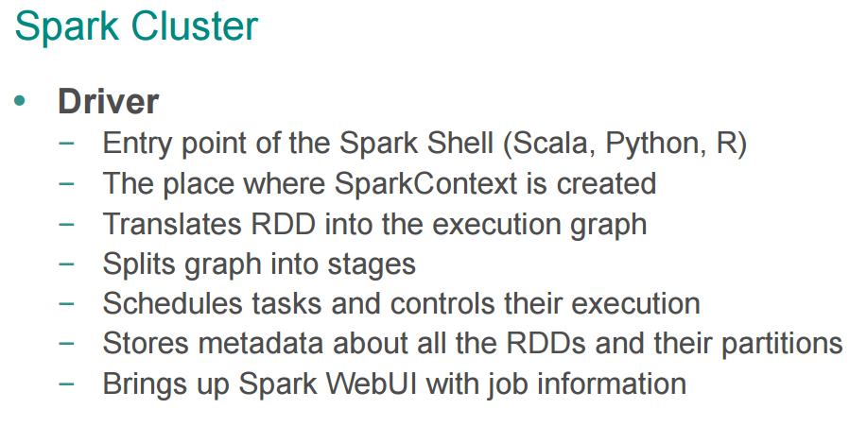
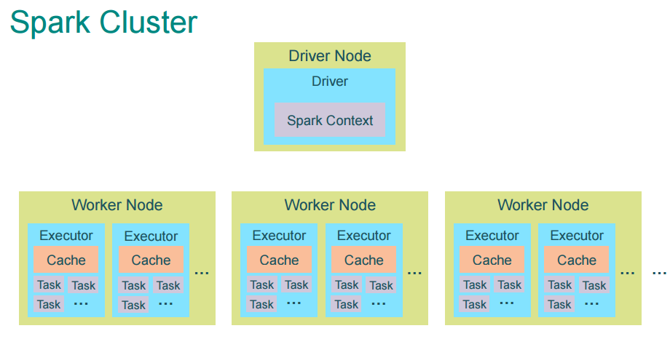
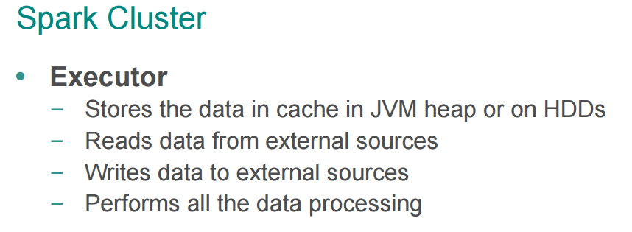
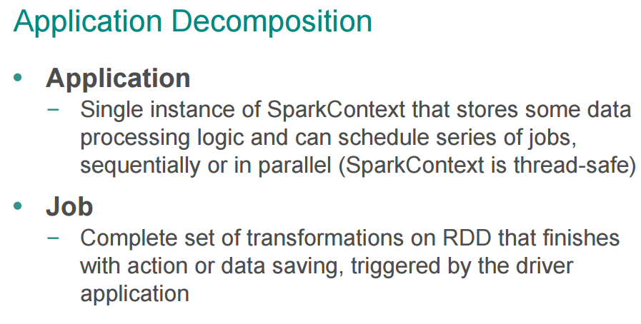
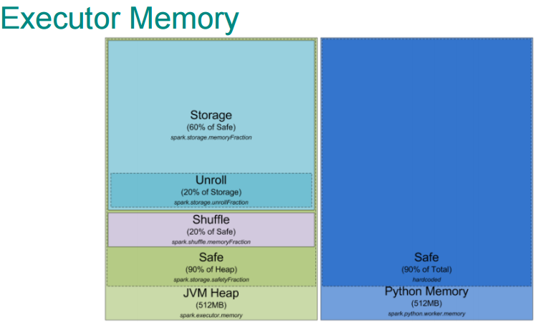
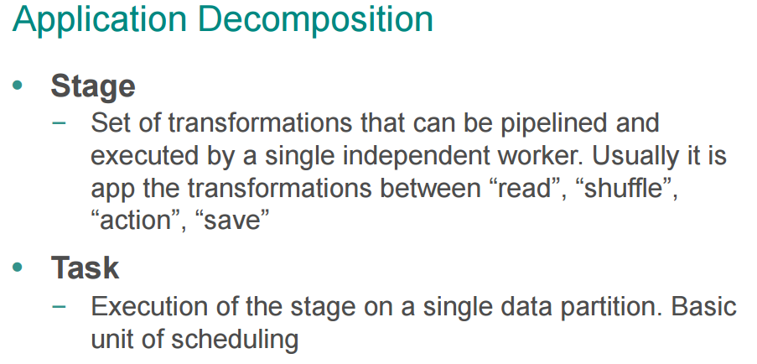

Slide 4
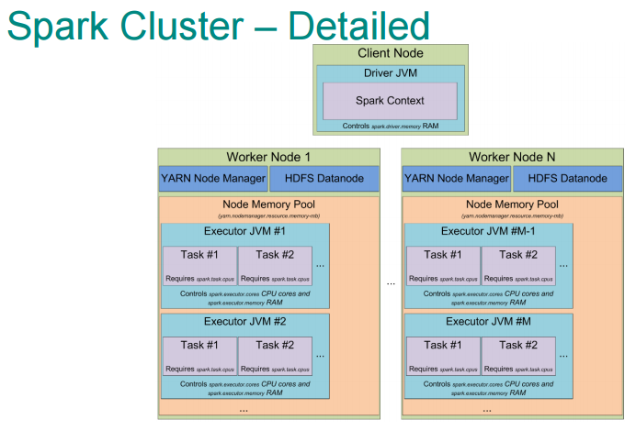

Slide 5
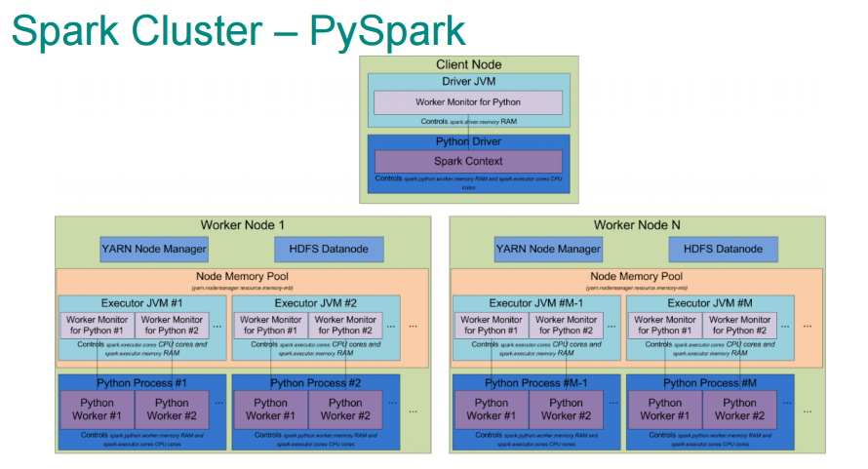

Slide 6
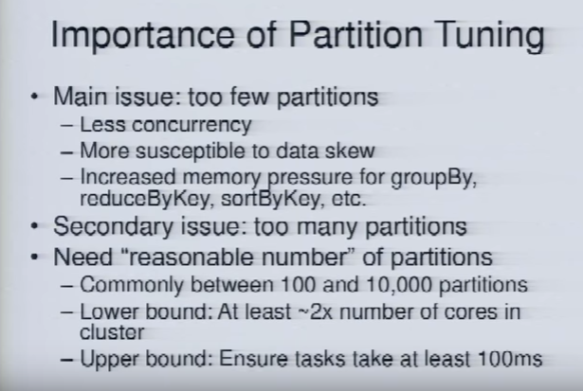
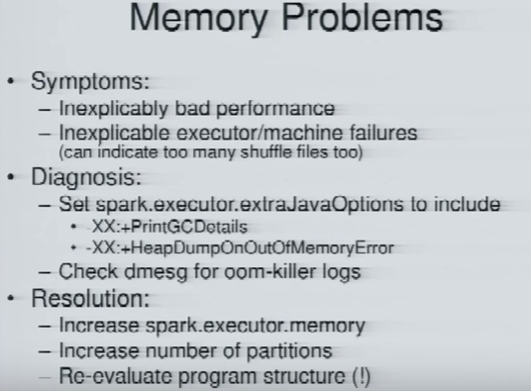
A Deeper Understanding of Spark Internals - Aaron Davidson (Databricks) : https://www.youtube.com/watch?v=dmL0N3qfSc8

Slide 7
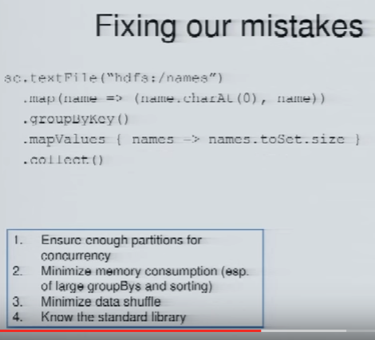
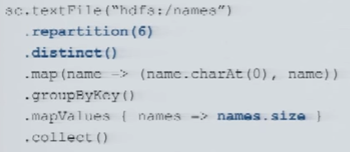
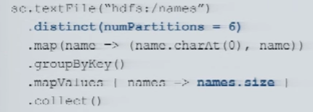
A Deeper Understanding of Spark Internals - Aaron Davidson (Databricks) : https://www.youtube.com/watch?v=dmL0N3qfSc8

Slide 8
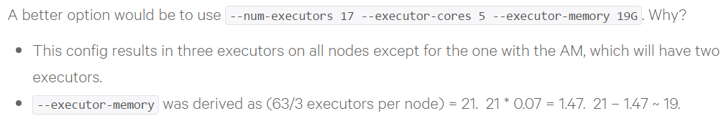
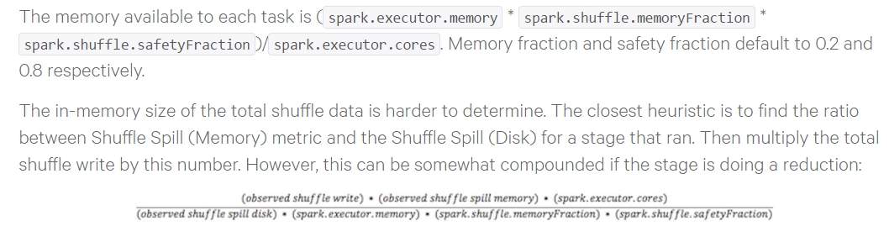
How-to: Tune Your Apache Spark Jobs
http://blog.cloudera.com/blog/2015/03/how-to-tune-your-apache-spark-jobs-part-2/

Slide 9
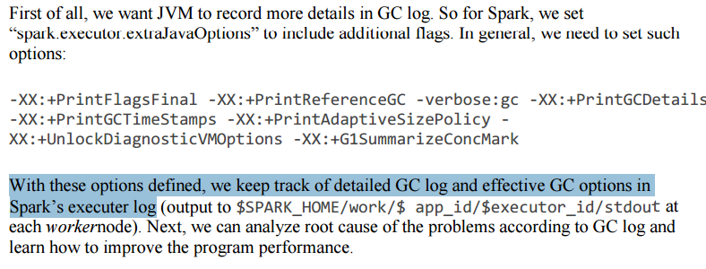
https://software.intel.com/sites/default/files/managed/20/e1/Tuning%20Java%20Garbage%20Collection%20for%20Spark%20Applications.pdf

Slide 10
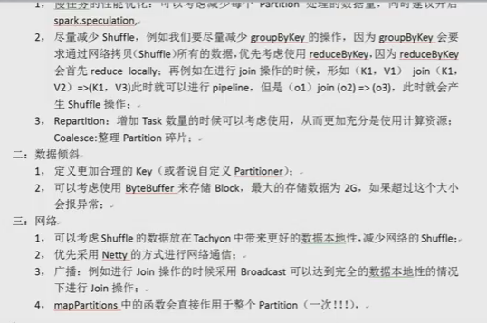

Slide 11
Spark-streaming
在流式计算中，数据是持续不断来的，有时候我们要对一些数据做跨周期(Duration)的统计，这个时候就不得不维护状态了。而状态管理对Spark 的 RDD模型是个挑战，因为在spark里，任何数据集都需要通过RDD来呈现，而RDD 的定义是一个不变的分布式集合。在状态管理中，比如Spark Streaming中的word-count 就涉及到更新原有的记录，比如在batch 1 中 A 出现1次，batch 2中出现3次，则总共出现了4次。这里就有两种实现：
获取batch 1 中的 状态RDD 和当前的batch RDD 做co-group 得到一个新的状态RDD。这种方式完美的契合了RDD的不变性，但是对性能却会有比较大的影响,因为需要对所有数据做处理，计算量和数据集大小是成线性相关的。这个我们后续会详细讨论。
第二种是一种变通的实现。因为没法变更RDD/Partition等核心概念，所以Spark Streaming在集合元素上做了文章，添加了 MapWithStateRDDRecord 这个东西。其实对应的就是模仿了partition的概念，然后里面维护了一个stateMap,存储最后的结果。
这两个方案分别对应了 updateStateByKey/mapWithState 的实现。
http://www.open-open.com/lib/view/open1455411074292.html

Slide 12
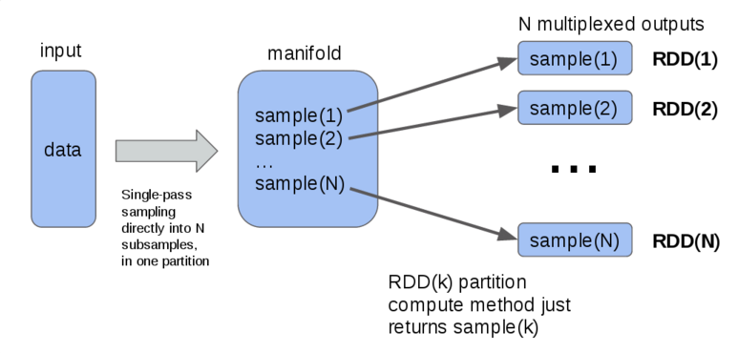
Efficient Multiplexing for Spark RDDs
http://erikerlandson.github.io/blog/2016/02/08/efficient-multiplexing-for-spark-rdds/

Slide 13
TL;DR: The performance should be same, except in case of shuffle-based operations where the number of reducers is not explicitly specified.
Let me answer in more detail by dividing the set of DStream operations into three categories.
1. Map-like operations (map, flatmap, filter, etc.) that does not involve any shuffling of data: Performance should virtually be the same in both cases. Either ways, in each batch, the operations on the batch's RDD are first set on the driver, and then the actions like on the RDD are executed. There are very very minor differences in the two cases of early foreachRDD and late foreachRDD (e.x, cleaning up for function closures, etc.) but those should make almost not difference in the performance.
2. Operations involving shuffle: Here is there is a subtle difference in both cases if the number of partitions is not specified. The default number of partitions used when using dstream.reduceByKey() and than when using dstream.foreachRDD(_.reduceByKey()) are different, and one needs to play around with the number of reducers to see what performs better. But if the number of reducers is explicitly specified and is the same both cases, then the performance should be similar. Note that this difference in the default numbers are not guaranteed to be like this, it could change in future implementations.
3. Aggregation-like operations (count, reduce): Here there is another subtle execution difference between
- dstream.count() which produces a DStream of single-element RDDs, the element being the count, and
- dstream.foreachRDD(_.count()) which returns the count directly.
In the first case, some random worker node is chosen for the reduce, in another the driver is chosen for the reduce. There should not be a significant performance difference.
4. Other operations including window ops and stateful ops (updateStateByKey), are obviously not part of the discussion as they cannot be (easily) done through early foreachRDD.
http://apache-spark-user-list.1001560.n3.nabble.com/Transforming-the-Dstream-vs-transforming-each-RDDs-in-the-Dstream-td16716.html

Slide 14
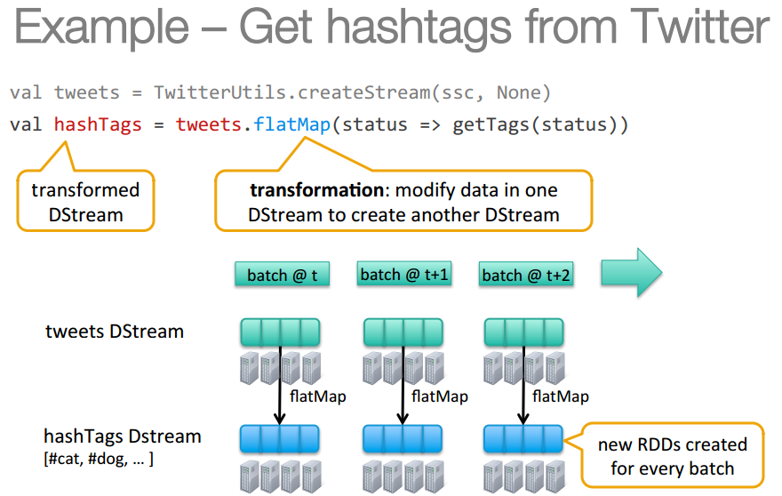

Slide 15
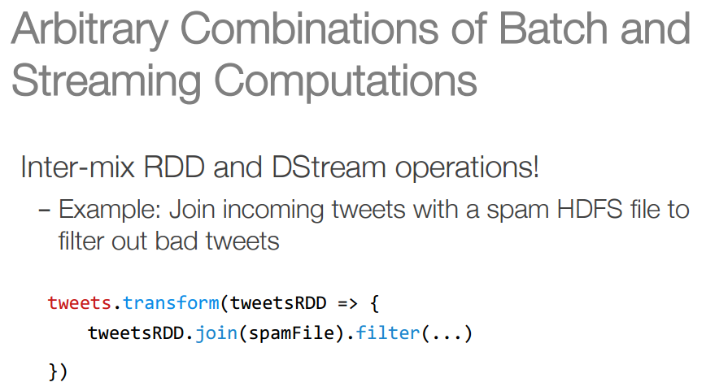
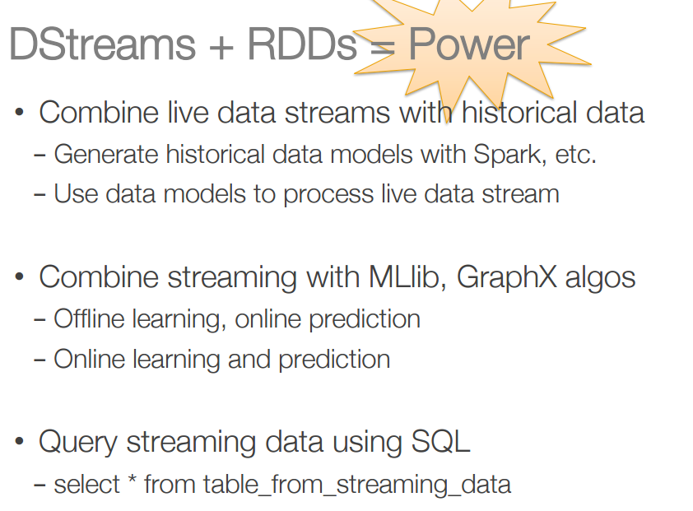

Slide 16
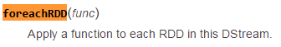
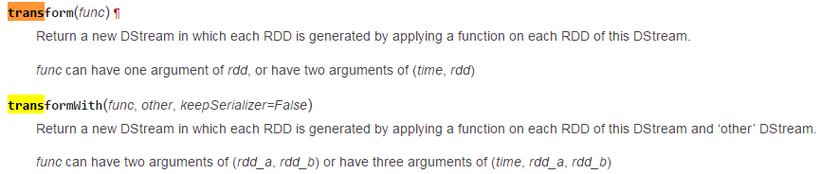
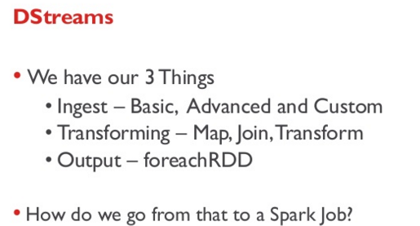
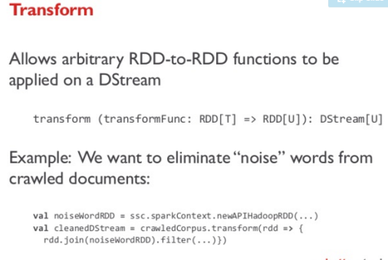
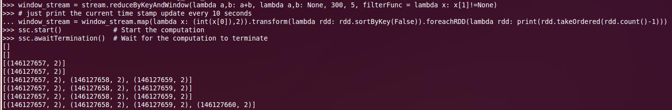
foreachRDD vs Transform
window_stream = window_stream.transform(lambda rdd: print(rdd.takeOrdered(rdd.count()-1)))
window_stream = window_stream.foreachRDD(lambda rdd: print(rdd.takeOrdered(rdd.count()-1)))
上面两个可以通过编译， 但只有用 foreachRDD才能真正 打印出 数据流

Slide 17
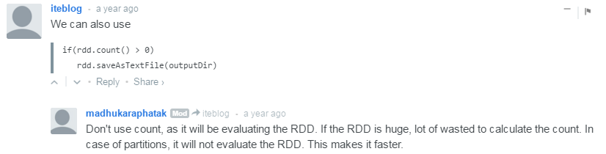

Slide 18
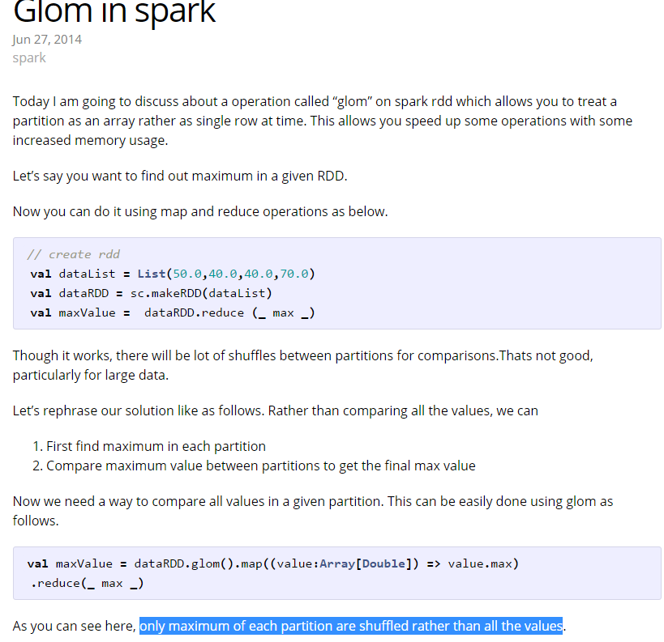
http://blog.madhukaraphatak.com/glom-in-spark/

Slide 19
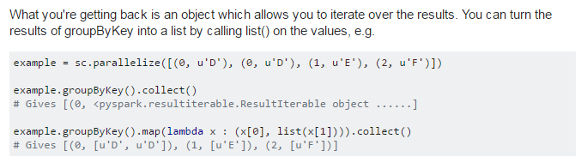
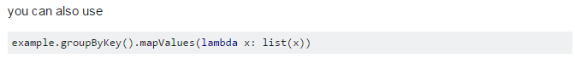

Slide 20
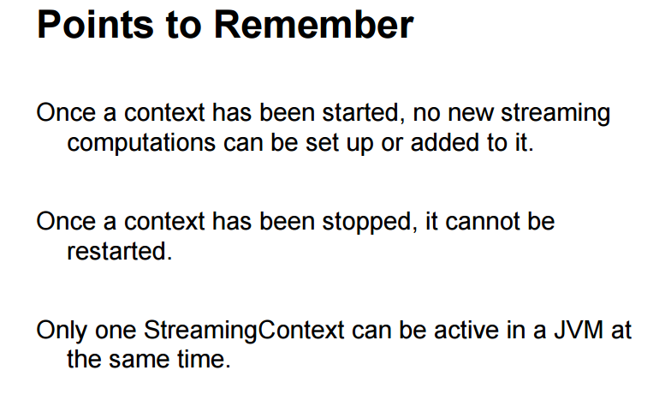

Slide 21
Just :::: foreachRDD(collect())
py4j.protocol.Py4JJavaError: An error occurred while calling z:org.apache.spark.api.python.PythonRDD.collectAndServe.
: java.lang.OutOfMemoryError: Java heap space
at org.apache.spark.util.io.ByteArrayChunkOutputStream.allocateNewChunkIfNeeded(ByteArrayChunkOutputStream.scala:66)
at org.apache.spark.util.io.ByteArrayChunkOutputStream.write(ByteArrayChunkOutputStream.scala:55)
at org.xerial.snappy.SnappyOutputStream.dumpOutput(SnappyOutputStream.java:343)
Exception in thread "dag-scheduler-event-loop" java.lang.OutOfMemoryError: Java heap space
at org.apache.spark.util.io.ByteArrayChunkOutputStream.allocateNewChunkIfNeeded(ByteArrayChunkOutputStream.scala:66)
at org.apache.spark.util.io.ByteArrayChunkOutputStream.write(ByteArrayChunkOutputStream.scala:55)
at org.xerial.snappy.SnappyOutputStream.dumpOutput(SnappyOutputStream.java:343)
WARN HeartbeatReceiver: Removing executor driver with no recent heartbeats: 123084 ms exceeds timeout 120000 ms
org.apache.spark.rpc.RpcTimeoutException: Futures timed out after [120 seconds]. This timeout is controlled by spark.rpc.askTimeout
when i use the kafka streaming with spark, the rdds store in memory and never be realesed, so OOM will happen after time. how can i release these rdds? i have used StorageLevel.NONE, but it didn't work.please help me , thanks!
the problem I'm having is that I am getting a Java heap space error that I don't know how to address. How do I view my current Java heap setting, and how do I increase it within the context of my setup. The error message I'm getting follows:

Slide 22
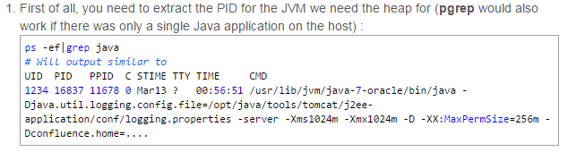
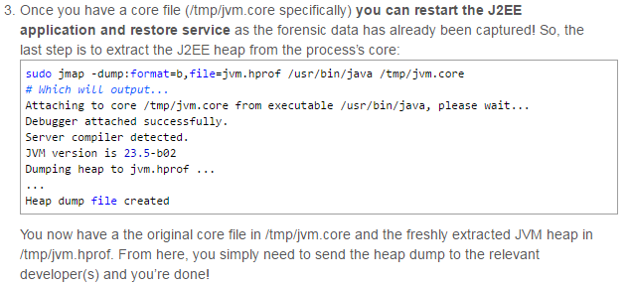
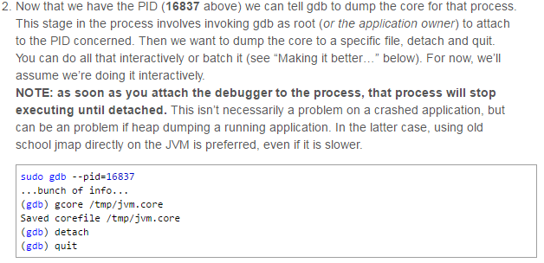
Dumping a JVM’s heap is an extremely useful tool
http://blogs.atlassian.com/2013/03/so-you-want-your-jvms-heap/
http://www.cockybook.com/?p=631
http://blog.163.com/shexinyang@126/blog/static/13673931220141192319439/
https://issues.apache.org/jira/browse/SPARK-7053

Slide 23
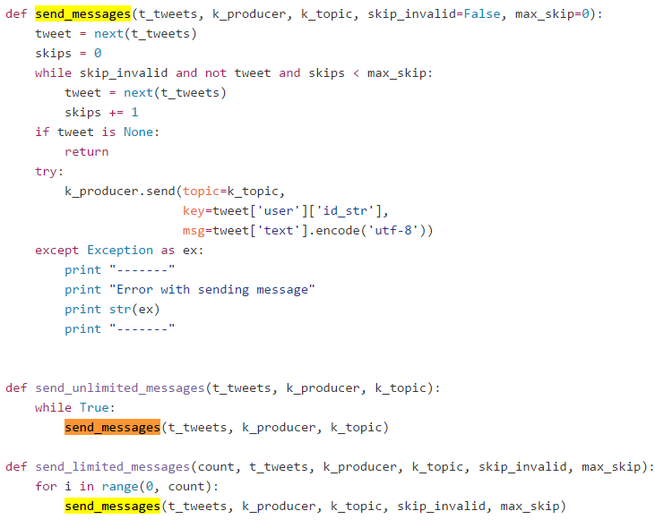
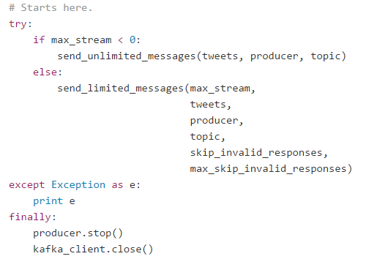
Sorry but this was totally my mistake. In my persistence logic, I was creating async http client instance in RDD foreach but was never closing it leading to memory leaks.
http://apache-spark-user-list.1001560.n3.nabble.com/Out-of-memory-with-Spark-Streaming-td13981.html
https://github.com/joychugh/learning-kafka/blob/545c23106e031a0b8cbab11ea23ae994d090ddb2/main.py

Slide 24
I have a few suggestions:
If your nodes have 6g, then use 6g rather than 4g, spark.executor.memory=6g. Make sureyou're using all the memory by checking the UI (it will say how much mem you're using)
Try using more partitions, you should have 2 - 4 per CPU. IME increasing the number of partitions is often the easiest way to make a program more stable (and often faster). For huge amounts of data you may need way more than 4 per CPU, I've had to use 8000 partitions in some cases!
Decrease the fraction of memory reserved for caching, using spark.storage.memoryFraction. If you don't use cache() or persist in your code, this might as well be 0. It's default is 0.6, which means you only get 0.4 * 4g memory for your heap. IME reducing the mem frac often makes OOMs go away. UPDATE: From spark 1.6 apparently we will no longer need to play with these values, spark will determine them automatically.
Similar to above but shuffle memory fraction. If your job need much shuffle memory then set it to a lower value (this might cause your shuffles to spill to disk which can have catastrophic impact on speed). Sometimes when it's a shuffle operation that's OOMing you need to do the opposite i.e. set it to something large, like 0.8, or make sure you allow your shuffles to spill to disk (it's the default since 1.0.0).
Watch out for memory leaks, these are often caused by accidentally closing over objects you don't need in your lambdas. The way to diagnose is to look out for the "task serialized as XXX bytes" in the logs, if XXX is larger than a few k or more than an MB, you may have a memory leak. See http://stackoverflow.com/a/25270600/1586965
Related to above; use broadcast variables if you really do need large objects.
http://spark.apache.org/docs/1.2.1/configuration.html
EDIT: (So I can google myself easier) The following is also indicative of this problem:

Slide 25
According to the gitbook Mastering Apache Spark by Jacek Laskowski:
You can run Spark in local mode. In this non-distributed single-JVM deployment mode, Spark spawns all the execution components - driver, executor, backend, and master - in the same JVM. This is the only mode where a driver is used for execution. Thus, if you are experiencing OOM errors with the heap, it suffices to adjust the driver-memoryrather than the executor-memory.
As far as I see, you have a MemoryError with ipython. At the same time your p_patterns.take(2)works, which means that your RDD is fine. So, can it be that simple, that you only need to cache your RDD before using it? Like
p_patterns = p_split.map(lambda (x,y): (patterns1(x), y)).cache()

Slide 26
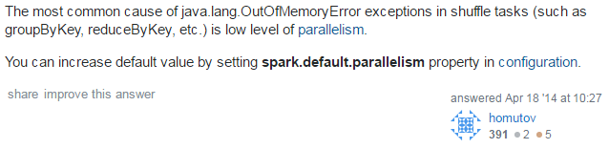
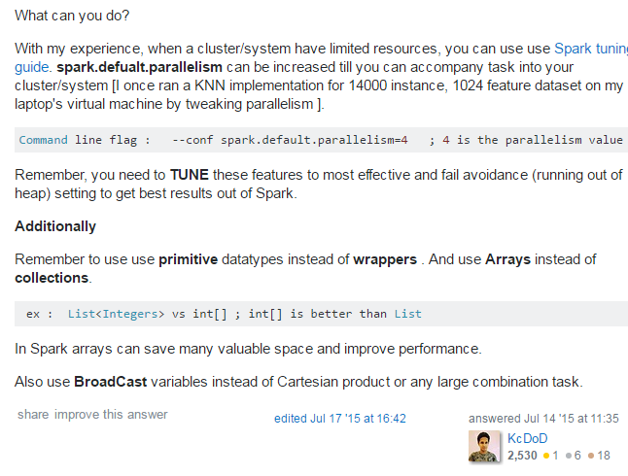
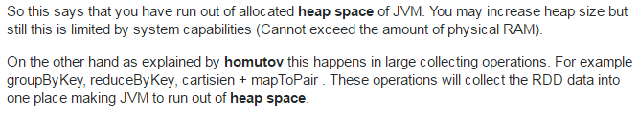
Spark runs out of memory when grouping by key
foreach auto run the loop on many nodes.
However, sometimes you want to do some operations on each node. For example, make a connection to database. You can not just make a connection and pass it into the foreach function: the connection is only made on one node.
So with foreachPartition, you can make a connection to database on each node before running the loop.
**********************
http://stackoverflow.com/questions/22637518/spark-runs-out-of-memory-when-grouping-by-key

Slide 27
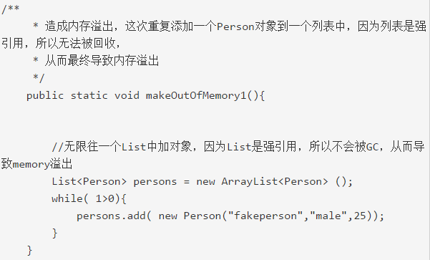
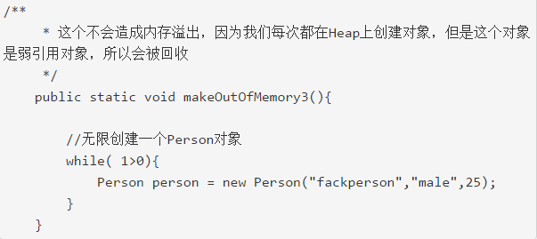
java :: memory leak
Shallow Size是对象本身占据的内存的大小，不包含其引用的对象。对于常规对象（非数组）的Shallow Size由其成员变量的数量和类型来定，而数组的ShallowSize由数组类型和数组长度来决定，它为数组元素大小的总和。
Retained Size=当前对象大小+当前对象可直接或间接引用到的对象的大小总和。(间接引用的含义：A->B->C,C就是间接引用) ，并且排除被GC Roots直接或者间接引用的对象
(1)只有强引用的对象（比如集合类型），在其对象中不断引用其他对象，这样才会导致memory leak. 弱引用的对象会被GC回收从而不会导致memory leak.
(2)对于一个不引用其他自定义类对象的对象，它的Shallow Heap大小和Retained Heap大小相等，并且这个大小为这个对象的对象头（取决于平台是32位还是64位） 和所有成员变量的按照类型计算出的大小（如果是对象引用就是4个byte或者8个byte，也取决于平台是32位还是64位，这决定了你寻址用的地址的尺寸）的总和，并且做补位操作。
(3)对于一个引用其他自定义类对象的对象，它的Shallow Heap大小和Retained Heap大小不相等，Retained Heap尺寸为该对象自己的Shallow Heap大小加上它所有直接或者间接引用到的对象的大小的总和（不包括被GC Root直接间接引用的对象）
http://www.tuicool.com/articles/3yMN7z

Slide 28
Workaround 3: Checkpoint the RDD
Another solution, used by Spark Streaming in particular, is to periodically call `RDD.checkpoint()`. This saves the current immutable state of the RDD to S3, snips the RDD lineage, and allows the intermediate shuffle files to be removed.
This requires a prior call `sc.setCheckpointDir()` with something like `/checkpoints`. This will save the checkpoint data to DBFS/S3 in that location.
This is the best of both worlds: the RDD is still recoverable, but the intermediate shuffle files can be removed from the Workers.
./bin/spark-submit --name "My app" ... --conf "spark.executor.extraJavaOptions=-XX:+PrintGCDetails -XX:+PrintGCTimeStamps -XX:MaxDirectMemorySize=512m" myApp.jar
https://forums.databricks.com/questions/277/how-do-i-avoid-the-no-space-left-on-device-error.html
https://mail-archives.apache.org/mod_mbox/spark-user/201509.mbox/%3CCAOe5pUS4zCZ1YSOyK+jBPJ3tY=0y9OR0NEczez5DHZs6WDS1cA@mail.gmail.com%3E

Slide 29
Execution memory refers to that used for computation in shuffles, joins, sorts and aggregations, while storage memory refers to that used for caching and propagating internal data across the cluster. In Spark, execution and storage share a unified region (M). When no execution memory is used, storage can acquire all the available memory and vice versa.

Slide 30
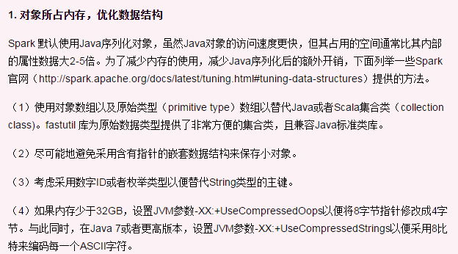
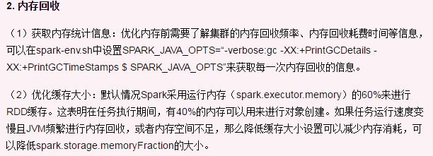
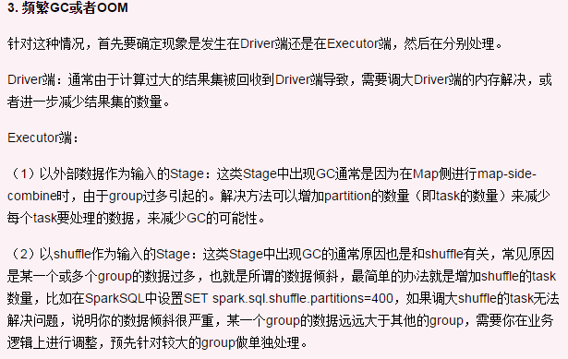
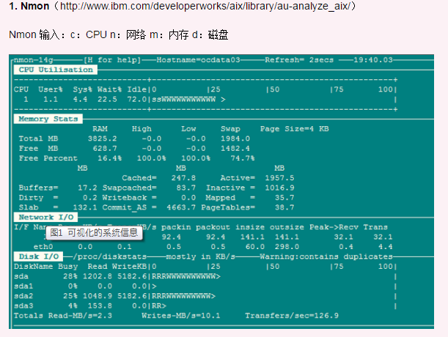
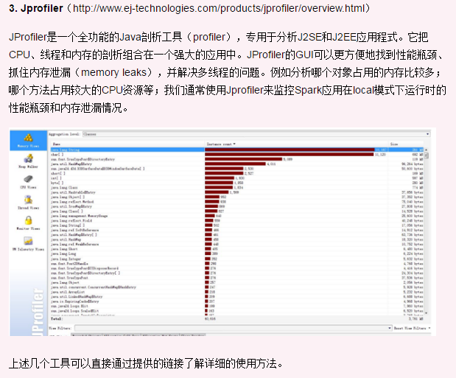
Spark性能调优
http://www.kuqin.com/shuoit/20150708/346975.html

Slide 31

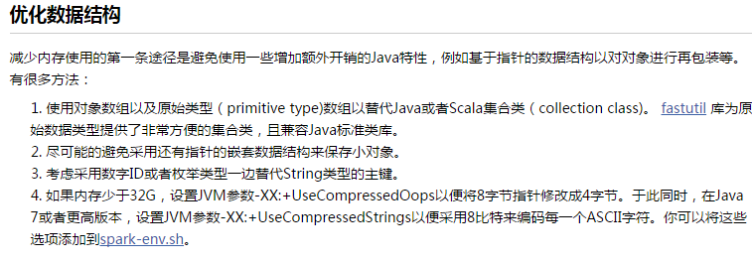




Spark 调优
http://www.oschina.net/translate/spark-tuning

Slide 32

(Why) do we need to call cache or persist on a RDD
http://stackoverflow.com/questions/28981359/why-do-we-need-to-call-cache-or-persist-on-a-rdd

Slide 33


Understanding the Performance of Spark Applications

Slide 34




https://www.youtube.com/watch?v=Wg2boMqLjCg

Slide 35


Slide 36


Spark Memory Management
https://0x0fff.com/spark-memory-management/
https://software.intel.com/sites/default/files/managed/20/e1/Tuning%20Java%20Garbage%20Collection%20for%20Spark%20Applications.pdf

Slide 38
当系统内存不足时，系统会将最近最不常用的内存段交换到交换空间，出现page out；
当程序要读的文件在内存中没有找到，这时候出现page fault，则从磁盘中读取到内存，其实也产生了page in；

Slide 39

PySpark Internals
https://cwiki.apache.org/confluence/display/SPARK/PySpark+Internals

Slide 40

Multiple streams
numStreams = 6 #read parallelism
kafkaStreams = [KafkaUtils.createStream(ssc, zkQuorum, "JSON-consumer", {topic: 1}) for _ in range (numStreams)]
https://github.com/donachys/SerIoTics/blob/a62aebf0a97a30c35f1f4c6ebb4fcc78ab93c2dd/JSON_consumer/SparkStreamingKafkaJSONSumRDB.py
https://github.com/hellsun24/nd-streaming-process/blob/d2fc1cbb80cfd56b33808b31f34bb49b1913ec4f/prototype/6003-rabbitmq-kafka-publisher/rabbitmq-to-kafka.py

Slide 41






